Slide 1

SECURE PAGE
Presented By : Vishal Naik
Self Project | 2024

Slide 2

2
INTRODUCTION
Objective: To build a simple and secure login page using Flask.
Key Features:
Secure login functionality (username & password).
Password field hidden (input masking).
Flash messages for login success or failure.
Beautiful design with modern CSS.
Self Project | 2024

Slide 3
3
PROJECT STRUCTURE
app.py
File Structure:
/project
/templates
login.html
app.py
Contains Flask app logic and routes.
Vishal Naik | 2024
login.html
Contains the login form and front-end design.

Slide 4
4
FLASK BACKEND (APP.PY)
User Credentials:
Flask Setup:
from flask import Flask, render_template, request, redirect, url_for, flash
app = Flask(__name__)
app.secret_key = 'your_secret_key'
Dummy user data: Username = 'user', Password = 'password123'.
Vishal Naik | 2024
Login Route:
Handles GET and POST requests.
Checks the entered credentials.
Redirects with a flash message on success or failure.

Slide 5
5
FRONT-END DESIGN (LOGIN.HTML)
Login Form HTML:
A form with username and password fields.
A submit button to trigger login.
Styling:
Centered login form.
Gradient background.
Smooth hover effects on buttons and input fields.
Flash Messages:
Success and error messages displayed with appropriate colors.
"Login Successful" or "Invalid Credentials".

Slide 6

6
CODE EXAMPLE - BACKEND LOGIC
Display the relevant part of app.py for handling form submissions and validation:
if request.method == 'POST':
username = request.form.get('username')
password = request.form.get('password')
if username == USER_CREDENTIALS['username'] and password == USER_CREDENTIALS['password']:
flash("Login Successful!", "success")
return redirect(url_for('home'))
else:
flash("Invalid Credentials", "danger")
return redirect(url_for('login'))

Slide 7
7
CODE EXAMPLE - FRONT-END (LOGIN.HTML)
Display the relevant part of login.html:
<input type="text" id="username" name="username" class="input-field" placeholder="Username" required>
<input type="password" id="password" name="password" class="input-field" placeholder="Password" required>
<button type="submit" class="btn-submit">Login</button>
CSS for Design:
Display key styling snippets to show how the form is made visually appealing.

Slide 8
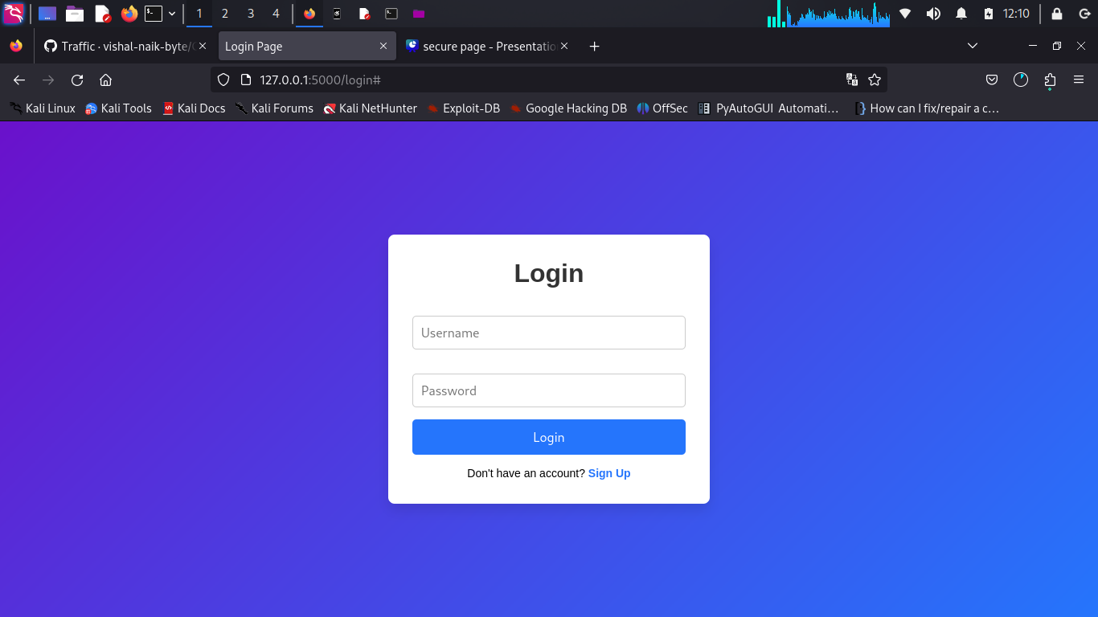
8
VISUAL
Vishal Naik | 2024

Slide 9
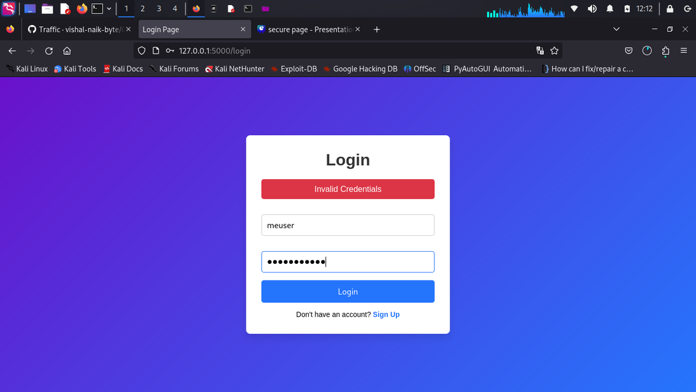
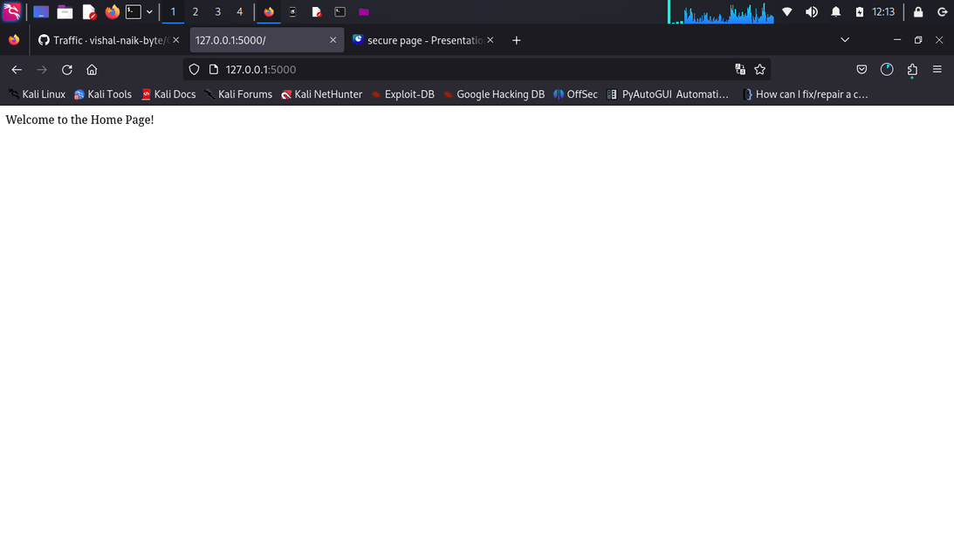
9
TESTING AND RESULTS
Vishal Naik| 2024

Slide 10
10
SECURITY CONSIDERATIONS
Password Masking: Password is hidden when typed.
Session Management: Flash messages are used for feedback after form submission.
Storing Passwords: In production, use hashed passwords (e.g., bcrypt).
Vishal Naik| 2024

Slide 11
11
FUTURE ENHANCEMENTS
Integrate a database to store user credentials securely.
Add email verification and password reset functionality.
Improve security with CAPTCHA to prevent bot logins.
Style improvements for mobile responsiveness.
Vishal Naik | 2024

Slide 12
12
CONCLUSION
Summary: We have built a simple yet effective login system using Flask with a modern design and basic authentication.
Next Steps: Continue adding features and security enhancements.
Vishal Naik| 2024

Slide 13
Self Project | 2024
THANK YOU
Presented By : Vishal Naik

